Slide 1
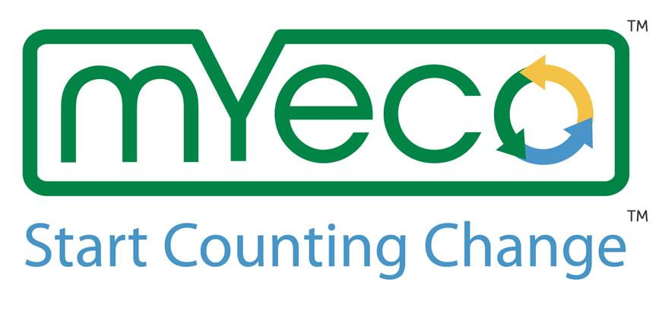
Presented by
Shantel Silva Chris Ciampa & Austin Solimine
on behalf of Peabody DECA

Slide 2
My Eco ~ Start Counting Change
Founded by CEO Kristen Brown
Created a program to incentivize consumers to reduce single bag use while shopping.
This goal consists of a kit of bags made from post-consumer waste. This is a mission to change consumer behavior for the betterment of society.

Slide 3
Mission
To decrease the use of single-use bags, My ECO wants to partner with schools across the country in a way that also would greatly benefit Peabody Public Schools.

Slide 4
Start Counting Change
1. PVMHS registers as a non-profit organization bank account.
2. We are given a QR code.
3. Shoppers that download the My Eco app click their charity (PVMHS)
4. If they shop with ANY reusable bag, and shop @ a participating store (Shaws), the QR code is scanned at the register.
5. For every scan, PVMHS counts change($)

Slide 5
There’s More to it.
1. As Peabody DECA all funds immediately come to our non-profit account. However, as a way to gain support:
- We can host a competition between all the school systems and the My ECO account gives us the opportunity to allocate funds and track their progress.
- My Eco uses a behavioral neuroscientist to email our consumers.

Slide 6
Our Strategies
1. Set up a table and presence at Shaws
2. Get meetings with the help of Kristen Brown with representatives of stores like Hannaford, Whole Foods, Stop and Shop, and Market Basket
3. Meet with the PTOs and principals of the other schools

Slide 7
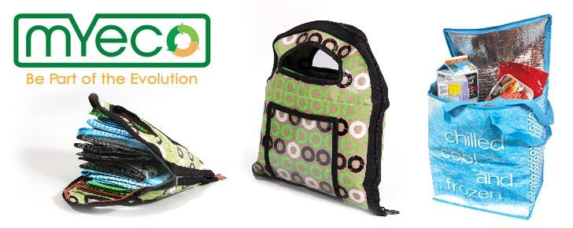
Money Breakdown
Bags are $25
PVMHS receives $7
Every $100 a shopper spends, net $0.40
Every $1000, net $4.00

Slide 8
Waste Management
Waste = issue for Peabody and surrounding communities
By spreading the use of reusable bags, we can cut down and reduce the amount of garbage Cut down hauling and recycling costs

Slide 9
Thank you
for
listening.

